Slide 1


Muhsin IDER
20/11/2023

Slide 2

Outline
Executive Summary
Introduction
Methodology
Results
Conclusion
Appendix

Slide 3
Executive Summary
Summary of methodologies
Summary of all results

Slide 4
Introduction
Background of the Project
- SpaceX, an industry leader in aerospace, has revolutionized space travel with its Falcon 9 rocket, known for its cost-effectiveness and reusability.
- The Falcon 9 rocket is a pivotal part of SpaceX's mission, frequently used for satellite deployment, cargo supply missions to the International Space Station, and even crewed flights.

Slide 5
Introduction
Problem Statement:
- Central to the project is the challenge of predicting the successful landing of the Falcon 9's first stage.
- The ability to accurately predict these landings is crucial; it directly impacts the cost and feasibility of space missions, as reusable rockets significantly reduce launch expenses.
Purpose of the Study:
- The study aims to leverage machine learning techniques to develop a predictive model for the Falcon 9 first stage landings.
By accurately forecasting these landings, the study seeks to enhance the efficiency and cost-effectiveness of SpaceX's launch operations.

Slide 6
Introduction
Scope of the Study:
- The analysis encompasses data gathered through web scraping and APIs, focusing on various parameters of Falcon 9 launches.
While comprehensive, the study concentrates on specific launch conditions and variables, with acknowledgment of its limitations in terms of the breadth of launch data considered.
Structure of the Report:
- Following this introduction, the report will detail the methodologies employed in data collection and analysis.
- Subsequent sections will present the results, discuss key findings, and provide conclusions and recommendations based on the study.

Slide 7

Section 1

Slide 8
Methodology
Executive Summary
Data collection methodology:
Data was collected through direct API calls to SpaceX's endpoints, which provide structured JSON data Python libraries were used.
Data was also collected using web scraping from Wikipedia.
Perform data wrangling
One hot encoding was applied to categorical features
Perform exploratory data analysis (EDA) using visualization and SQL
Perform interactive visual analytics using Folium and Plotly Dash
Perform predictive analysis using classification models
How to build, tune, evaluate classification models

Slide 9
Data Collection
Data collection was done using get request by sending HTTP requests to the SpaceX API
Pandas was used for data manipulation and analysis - json_normalize was used to convert JSON data into a structured Pandas DataFrame.
Data was cleaned and checked for missing values and missing values were addressed where necessary.
Also, web scraping with BeautifulSoup was performed from Wikipedia for Falcon 9 launch records.
For future analysis, The launch records was extractred and parsed as HTML table and converted into a pandas dataframe.

Slide 10
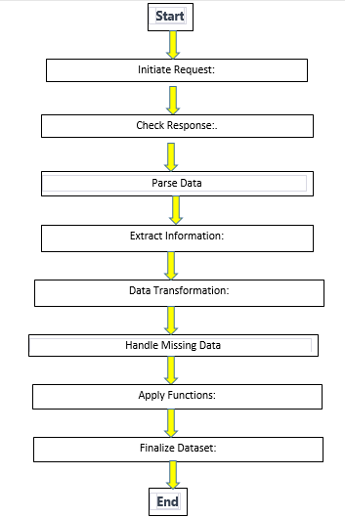
Place your flowchart of SpaceX API calls here
Data Collection – SpaceX API
Key steps for data collection:
Initiate Request:
Check Response:.
Parse Data:
Extract Information:
Data Transformation:
Handle Missing Data:
Apply Functions:
Finalize Dataset:
Export Data:
GitHub Permalink of the completed SpaceX API calls notebook is: https://github.com/muhsinider/testrepo/blob/297f3240a3826c784a79cb5e1c88175244eaadda/jupyter-labs-spacex-data-collection-api.ipynb

Slide 11
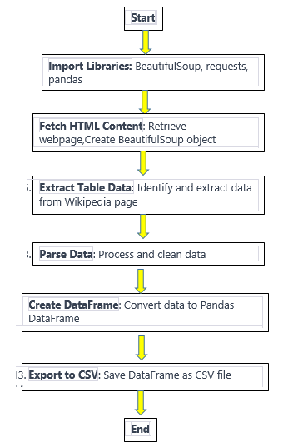
Data Collection - Scraping
Web Scraping Process in the SpaceX Project
Libraries Imported: Required Python libraries were installed and imported.
Functions Defined: Custom functions for processing web data were developed.
Task 1 - Page Requested: Web content was fetched with an HTTP GET request, and a BeautifulSoup object was created.
Task 2 - Columns Extracted: Table headers were identified, and column names were extracted.
Task 3 - DataFrame Created: A dictionary was populated with table data, and variations were handled.
DataFrame & Export: The dictionary was transformed into a Pandas DataFrame, and it was exported as a CSV file.
GitHub Permalink of the completed web-scraping notebook is: https://github.com/muhsinider/testrepo/blob/297f3240a3826c784a79cb5e1c88175244eaadda/jupyter-labs-spacex-data-collection-api.ipynb

Slide 12
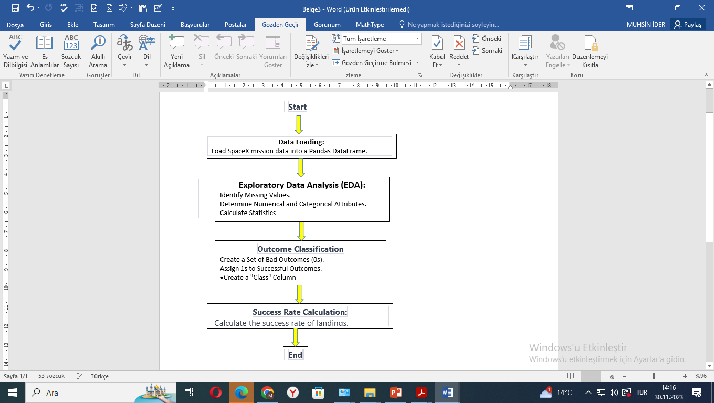
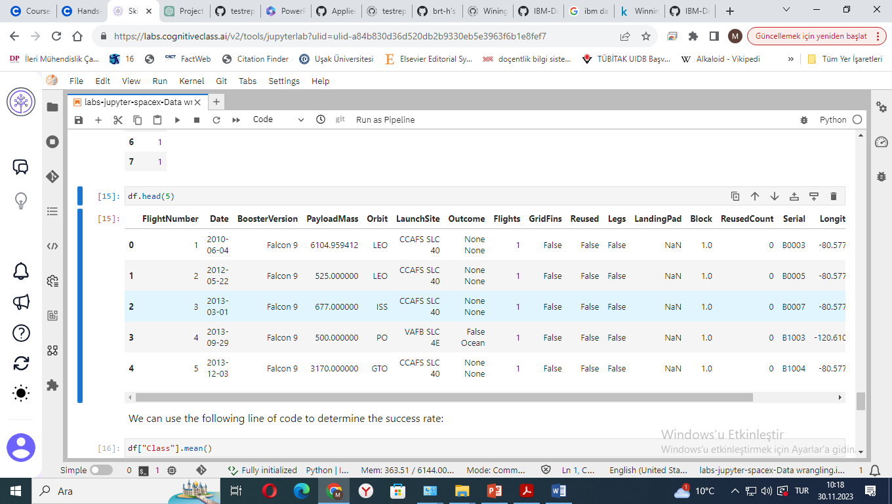
Data Wrangling
Data Wrangling Process:
Data Loading: Load SpaceX mission data into a Pandas DataFrame.
Exploratory Data Analysis (EDA):
Identify Missing Values.
Determine Numerical and Categorical Attributes.
Calculate Statistics on Launch Sites, Orbits, and Mission Outcomes.
Outcome Classification:
Create a Set of Bad Outcomes (0s).
Assign 1s to Successful Outcomes.
Create a "Class" Column to Represent Landing Outcomes.
Success Rate Calculation: Calculate the success rate of landings.
GitHub Permalink of the completed data wrangling notebook is:https://github.com/muhsinider/testrepo/blob/297f3240a3826c784a79cb5e1c88175244eaadda/labs-jupyter-spacex-Data%20wrangling.ipynb

Slide 13
EDA with Data Visualization
Various charts were plotted to explore the relationship between different variables related to the Falcon 9 rocket launches
Flight Number vs. Payload Mass (Scatter Plot): Explores the trend of successful landings with respect to the number of flights and payload mass.
Flight Number vs. Launch Site (Categorical Plot): Visualizes the distribution of flight numbers across different launch sites with success rate indication.
Payload vs. Launch Site (Scatter Plot): Investigates if certain launch sites are associated with specific payload masses and their success rates.
Success Rate by Orbit Type (Bar Chart): Compares the success rate of missions for different orbit types.
Flight Number vs. Orbit Type (Scatter Plot): Analyzes the correlation between the number of flights and orbit types with respect to mission success.
Payload vs. Orbit Type (Scatter Plot): Assesses the relationship between payload mass and orbit types, focusing on mission outcomes.
Yearly Success Trend (Line Chart): Depicts the change in mission success rates over the years, indicating progress or decline.
GitHub Permalink of the completed EDA with Data Visualization notebook İs:https://github.com/muhsinider/testrepo/blob/297f3240a3826c784a79cb5e1c88175244eaadda/jupyter-labs-eda-dataviz.ipynb.jupyterlite.ipynb

Slide 14
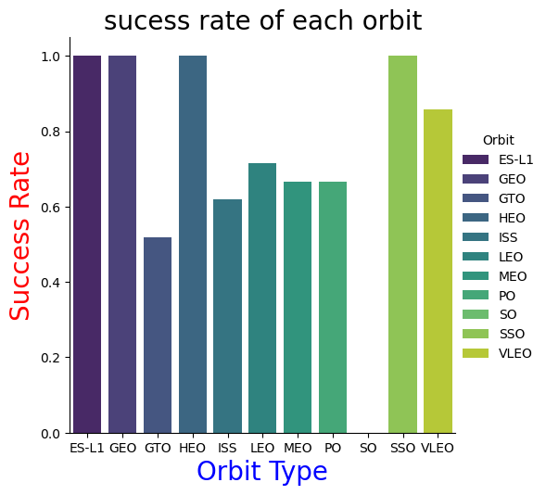
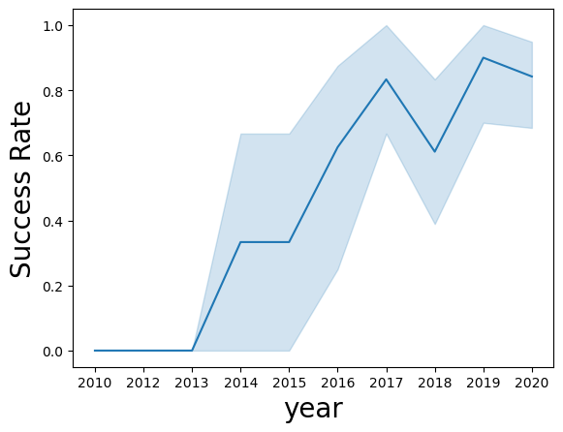
EDA with Data Visualization
Various charts were plotted to explore the relationship between different variables related to the Falcon 9 rocket launches

Slide 15
EDA with SQL(1)
A series of SQL queries were performed to understand and analyze the SpaceX dataset.
Unique Launch Sites:
Queried to list all distinct SpaceX launch sites.
Launch Sites with 'CCA':
Retrieved 5 records where launch sites start with 'CCA'.
Total Payload for NASA (CRS):
Calculated the sum of payload mass for missions with NASA (CRS) as the customer.
Average Payload Mass for F9 v1.1 Booster:
Computed the average payload mass carried by the Falcon 9 version 1.1 booster.
First Successful Ground Pad Landing Date:
Identified the date of the first successful Falcon 9 landing on a ground pad.
Successful Drone Ship Landings with Specific Payload:
Listed booster versions that had successful drone ship landings with payloads between 4000 and 6000 kg.
GitHub Permalink of the completed EDA with SQL notebook İs: https://github.com/muhsinider/testrepo/blob/297f3240a3826c784a79cb5e1c88175244eaadda/jupyter-labs-eda-sql-coursera_sqllite.ipynb

Slide 16
EDA with SQL(2)
SQL queries continued.
Mission Outcomes (Success/Failure):
Counted the total number of successful and failed mission outcomes.
Booster Versions with Max Payload:
Selected the booster versions that have carried the maximum payload mass.
2015 Drone Ship Failures by Month:
Extracted the month and details of failed drone ship landings in the year 2015.
Ranking of Landing Outcomes by Count:
Ranked the different types of landing outcomes by their occurrence count between 2010-06-04 and 2017-03-20.
GitHub Permalink of the completed EDA with SQL notebook İs: https://github.com/muhsinider/testrepo/blob/297f3240a3826c784a79cb5e1c88175244eaadda/jupyter-labs-eda-sql-coursera_sqllite.ipynb

Slide 17

Build an Interactive Map with Folium
Map objects such as markers, circles, lines, etc. were added to a folium map to provide interactive analytical capabilities and derive insights about the correlation between launch site locations and success rates.
Markers pinpointed launch sites for easy location identification.
Circle markers emphasized launch site surroundings to explore geographical influences on launch success.
Marker clusters organized multiple markers at single coordinates, clarifying maps of sites with numerous launches.
Color coding differentiated successful from failed launches for quick visual assessment.
The Mouse Position Plugin enabled precise distance measurements from launch sites to key areas like coastlines and railways.
Polylines visualized distances to highlight strategic launch site positioning relative to infrastructure.
Distance calculations determined exact proximities, informing launch site selection based on surrounding features.
GitHub Permalink of the completed interactive map with Folium map notebook İs: https://github.com/muhsinider/testrepo/blob/297f3240a3826c784a79cb5e1c88175244eaadda/lab_jupyter_launch_site_location.jupyterlite.ipynb

Slide 18
Build a Dashboard with Plotly Dash
An interactive dashboard using Plotly Dash was built to allow users to interactively filter and analyze the launch data based on specific criteria like launch site and payload mass.
Pie Chart: The success rates by launch site are displayed, allowing for a comparative analysis to be conducted swiftly.
Dropdown Menu: The data for the pie chart is filtered, either by a specific launch site or all sites combined, ensuring a customizable visualization experience.
Scatter Plot: A correlation between payload mass and launch outcomes is presented, with each booster version distinguished by color, providing nuanced insights into performance.
Range Slider: The scatter plot data is refined by payload mass range, facilitating an examination of how varying payload sizes impact launch success.
GitHub Permalink of the completed Plotly Dash jupyter notebook İs: https://github.com/muhsinider/testrepo/blob/297f3240a3826c784a79cb5e1c88175244eaadda/Muhsin_ider-spacex_dash_app.py

Slide 19
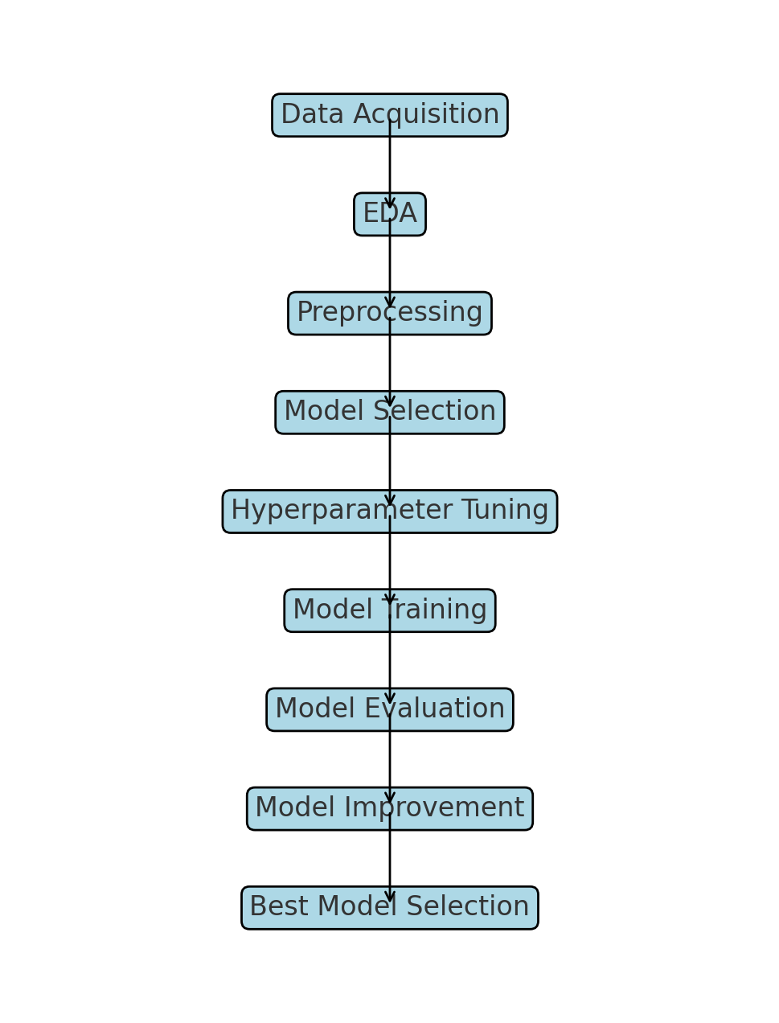
Predictive Analysis (Classification)
Machine learning pipeline to predict the success of SpaceX Falcon 9 first-stage landings.
Exploratory Data Analysis: Determined the labels machine learning model by exploring the dataset.
Data Standardization: Standardized the features in dataset to ensure fair weighting in the model.
Training/Test Split: Split the data to evaluate the model's performance on unseen data.
Hyperparameter Tuning: Used GridSearchCV to find the best parameters for SVM, Decision Trees, and Logistic Regression to optimize model performance.
Model Comparison: Compared different models to determine which performs best on test data.
Confusion Matrix Plotting: Visualized model performance to identify issues with false positives and negatives.
GitHub Permalink of the completed predictive analysis lab jupyter notebook İs: https://github.com/muhsinider/testrepo/blob/297f3240a3826c784a79cb5e1c88175244eaadda/SpaceX_Machine_Learning_Prediction_Part_5.jupyterlite.ipynb

Slide 20
Results
The following outline was used to present project analysis:
Exploratory data analysis results
Interactive analytics demo in screenshots
Predictive analysis results

Slide 21

Section 2

Slide 22
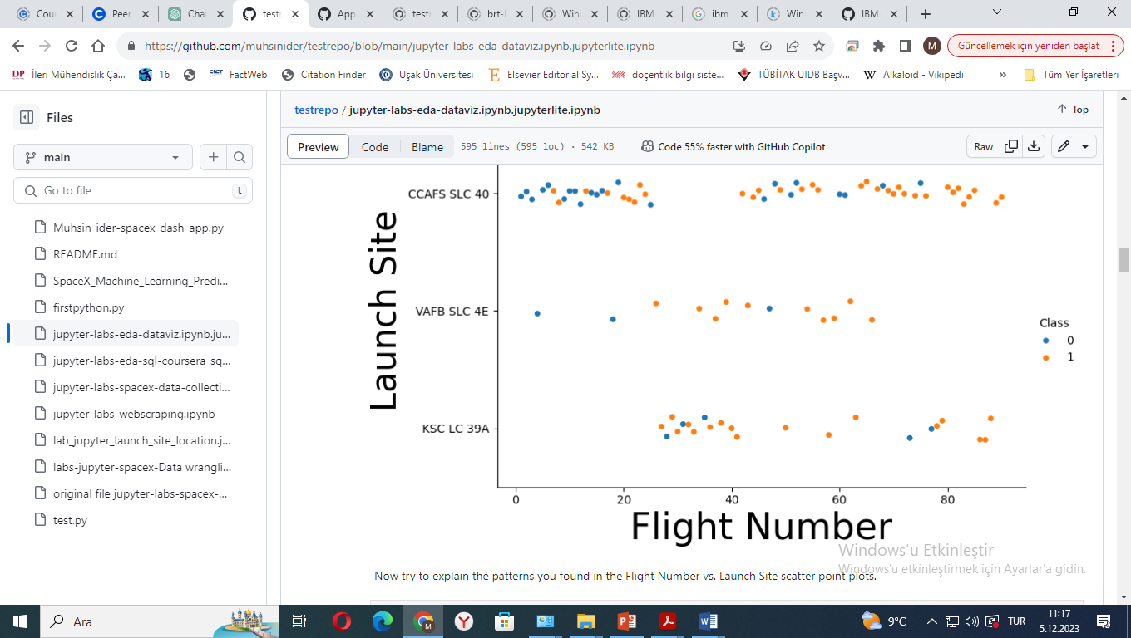
Flight Number vs. Launch Site
CCAFS SLC 40: Most active site with a higher number of flights; shows initial unsuccessful attempts that decrease over time, suggesting operational improvements.
Early Challenges: At CCAFS SLC 40, a noticeable cluster of unsuccessful flights (Class 0) in the beginning hints at initial difficulties in launch operations.
Increasing Success: For CCAFS SLC 40, the rise in successful flights (Class 1) with advancing flight numbers may indicate learning and technological enhancements.
VAFB SLC 4E: Features fewer flights with a balanced mix of successes and failures, lacking a discernible trend across flight numbers.
KSC LC 39A: Similar to CCAFS SLC 40, it experienced several early failures, but shows an upward trend in success rate as flight numbers grow.
Learning Curve: The overall increase in Class 1 outcomes over time across all sites suggests a learning curve effect, with subsequent flights benefiting from past experiences.
Complex Factors: The mixed distribution of flight outcomes across all sites and flight numbers points to multiple influencing factors beyond just the number of flights.

Slide 23
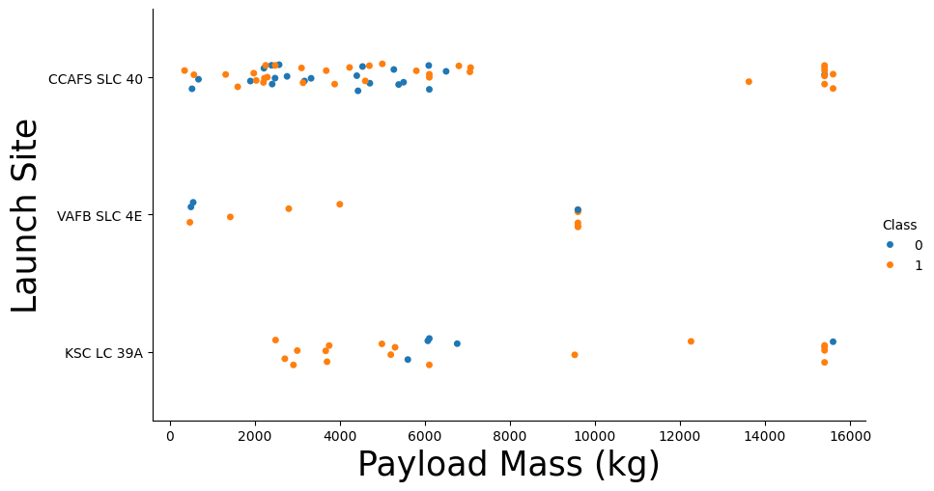
Payload vs. Launch Site
Payload Success Correlation: Higher payload masses generally correlate with increased launch success rates.
Over 7,000 kg Payloads: Launches above 7,000 kg are predominantly successful.
KSC LC 39A Record: 100% success rate for payloads under 5,500 kg.
VAFB SLC 4E Capacity: No launches over ~10,000 kg payload mass.
CCAFS SLC 40 Activity: Most frequent launch site with diverse payload range and improving success rate.
Learning Curve Evident: Improved success rate over time suggests operational advancements.
Complex Influences: Various factors, not just payload mass, affect launch outcomes.

Slide 24
Success Rate vs. Orbit Type
Confirmed 100% Success:
ES-L1, GEO, HEO, SSO
High Success (Approximately 90%):
VLEO
Moderate Success (Approximately 60-70%):
LEO, MEO, PO
Just Below 60% Success:
ISS, GTO
Very Low Success (<10%):
SO

Slide 25
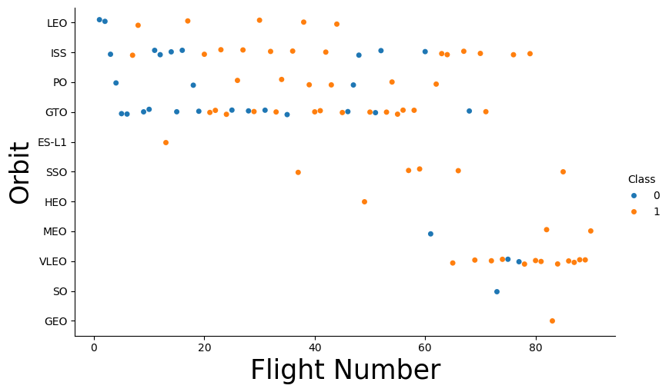
Flight Number vs. Orbit Type
The success of flights in LEO orbit may correlate with the number of flights, suggesting a learning curve effect. However, for GTO and other orbits, success seems less correlated with flight number, hinting at the influence of other factors or a smaller dataset to draw definitive conclusions
ISS Orbit: There is a mix of success and failures across the flight numbers, with no apparent increasing or decreasing trend.
PO Orbit: This orbit has fewer flights compared to LEO and GTO, but it shows a mix of successes and failures.
MEO, SSO, ES-L1, VLEO Orbits: These orbits have a smaller number of flights, but they show a high success rate, indicated by the prevalence of Class 1 points.
HEO, SO, GEO Orbits: These have very few points, which makes it difficult to establish any trend from the available data.

Slide 26
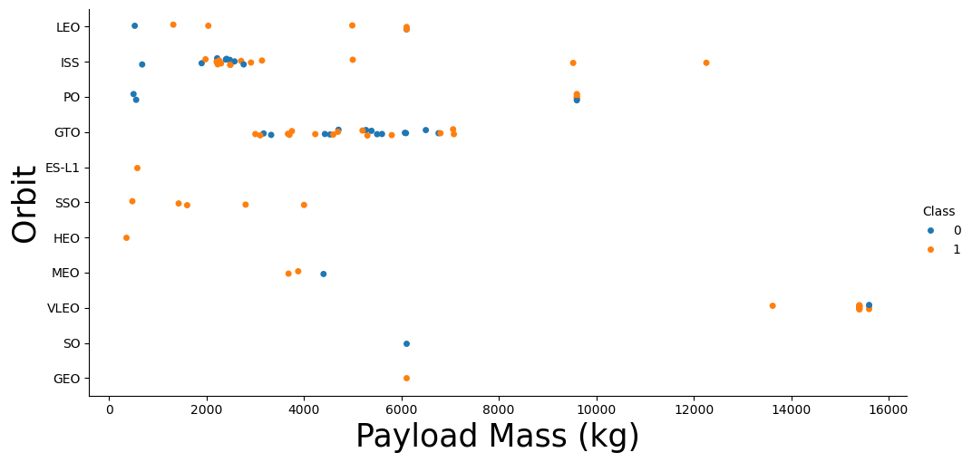
Payload vs. Orbit Type
Some orbits demonstrate consistent success regardless of payload mass (like LEO), others (such as GTO) do not show a clear pattern, indicating that success in these orbits may be influenced by a variety of factors, not just payload mass.
LEO Orbit: High success rate across various payload masses.
ISS Orbit: Generally successful, with some failures at lower payloads.
GTO Orbit: Mixed success, no clear link to payload mass.
Other Orbits (ES-L1, SSO, HEO, MEO, VLEO): Fewer launches but mostly successful, independent of payload size.
SO Orbit: Limited data, but includes both success and failure.
GEO Orbit: Small sample size, yet high success observed.

Slide 27
Launch Success Yearly Trend
The overall decade trend shows marked improvement in the success rate, with a little dip occurring in 2020.
2010: Started with a low success rate.
2010-2013: Steady increase in success rate.
2013-2017: Some fluctuation but generally upward trend.
2018: Slight decrease in success rate from 2017.
2019: Success rate recovers and improves.
2020: Appears to show a little drop in success rate.,

Slide 28
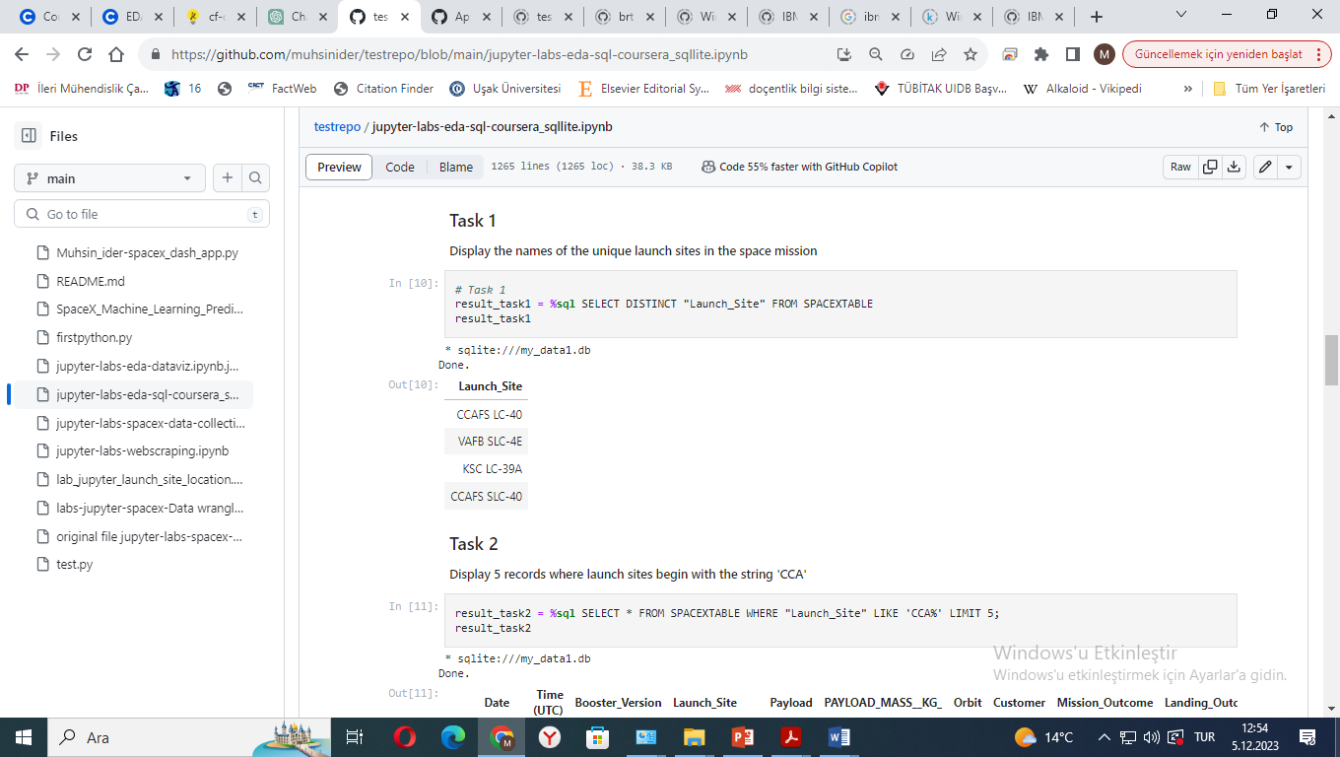
All Launch Site Names
Objective: Identify unique launch sites in the SpaceX dataset.:
Select: Distinct launch site names (SELECT DISTINCT Launch_Site).
From: SpaceX dataset table (FROM SPACEXTABLE).
Purpose: To explore the variety and uniqueness of SpaceX launch locations.

Slide 29
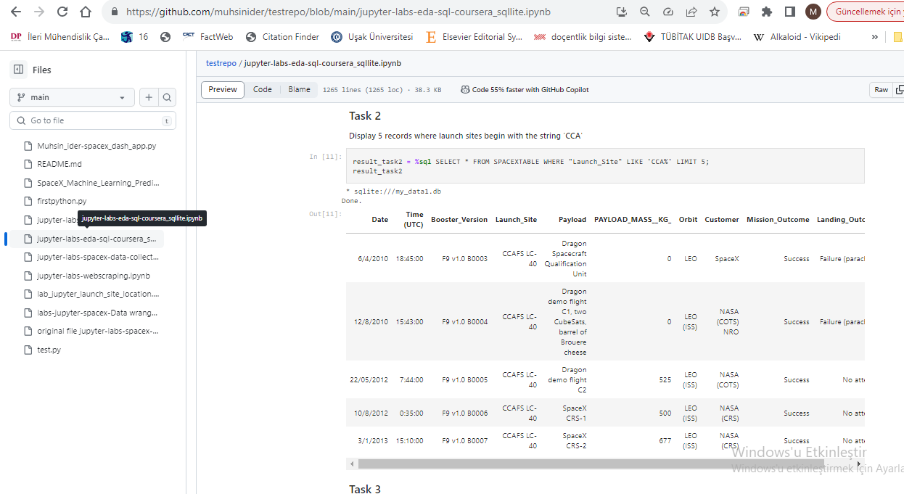
Launch Site Recordings Names Beginning with 'CCA'
Objective: Display records for launch sites starting with 'CCA'.
Query Details:
Select: All columns (SELECT *).
From: SpaceX dataset table (FROM SPACEXTABLE).
Criteria: Launch sites beginning with 'CCA' (WHERE Launch_Site LIKE 'CCA%').
Limit: Show only the first 5 matching records (LIMIT 5).
Purpose: To analyze and compare specific launch site data.

Slide 30
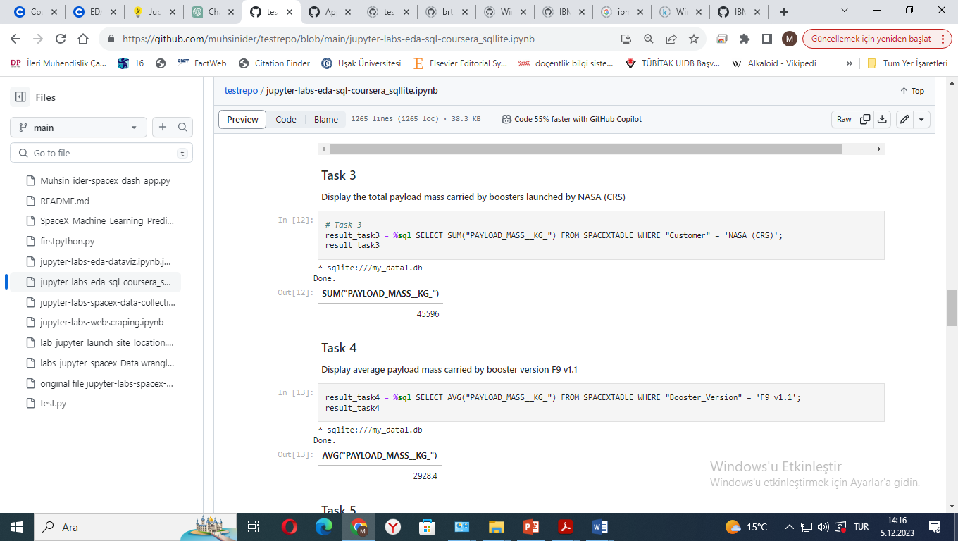
Total Payload Mass
Objective: Calculate the total payload mass carried by boosters launched by NASA under the CRS (Commercial Resupply Services) program.
Query Components:
SELECT Statement: Use SUM("PAYLOAD_MASS__KG_") to calculate the total payload mass.
FROM Clause: The table containing the data is SPACEXTABLE.
WHERE Clause: Filters records where the customer is NASA (CRS), specified as WHERE "Customer" = 'NASA (CRS)'.
Purpose: To assess the total mass carried to space by SpaceX for NASA's CRS missions.
FOUND AS 45596

Slide 31
Average Payload Mass by F9 v1.1
Objective: Determine the average payload mass carried by the Falcon 9 version 1.1 booster.
Query Components:
SELECT Statement: Uses AVG("PAYLOAD_MASS__KG_") to calculate the average payload mass.
FROM Clause: The data is sourced from the SPACEXTABLE table.
WHERE Clause: Filters records for the Falcon 9 version 1.1 booster, specified as WHERE "Booster_Version" = 'F9 v1.1'.
Purpose: To understand the payload capacity efficiency of the Falcon 9 version 1.1 booster.
FOUND AS 2928.4

Slide 32
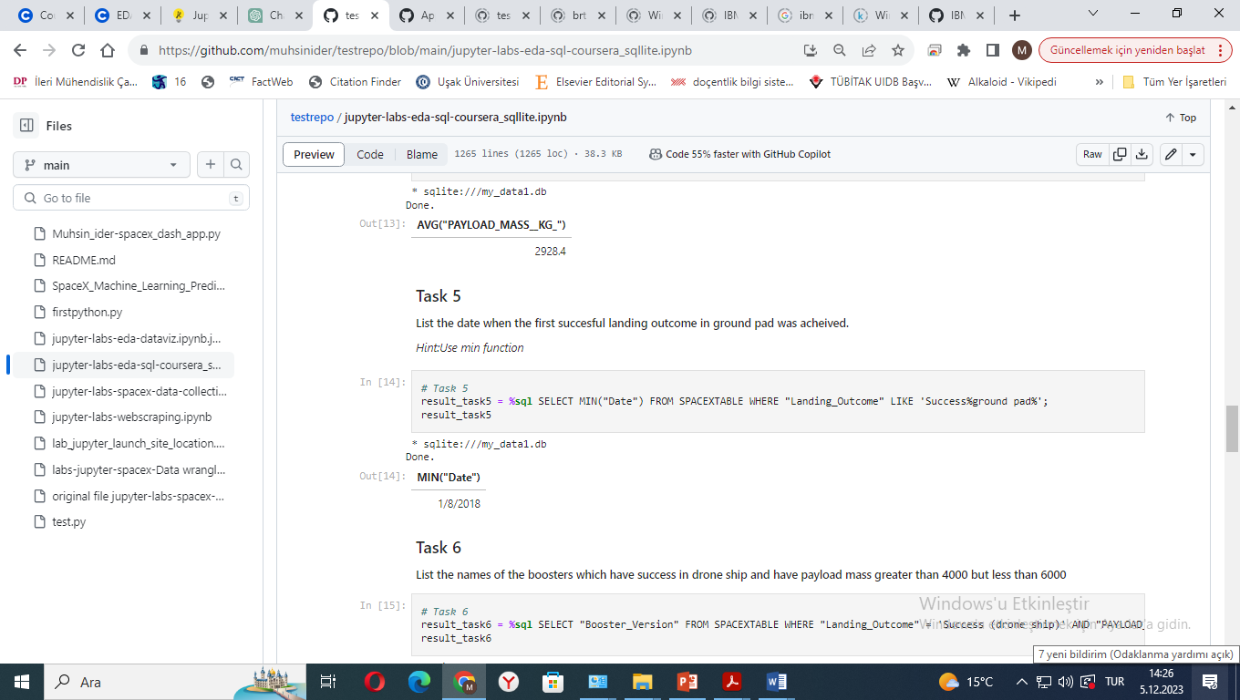
First Successful Ground Landing Date
Objective: Identify the date of the first successful landing on a ground pad.
Query Components:
SELECT Statement: Utilizes MIN("Date") to find the earliest date.
FROM Clause: Data is drawn from the SPACEXTABLE table.
WHERE Clause: Filters for successful ground pad landings, specified as WHERE "Landing_Outcome" LIKE 'Success%ground pad%'.
Purpose: To pinpoint when SpaceX first achieved a successful ground pad landing, marking a significant milestone.

Slide 33
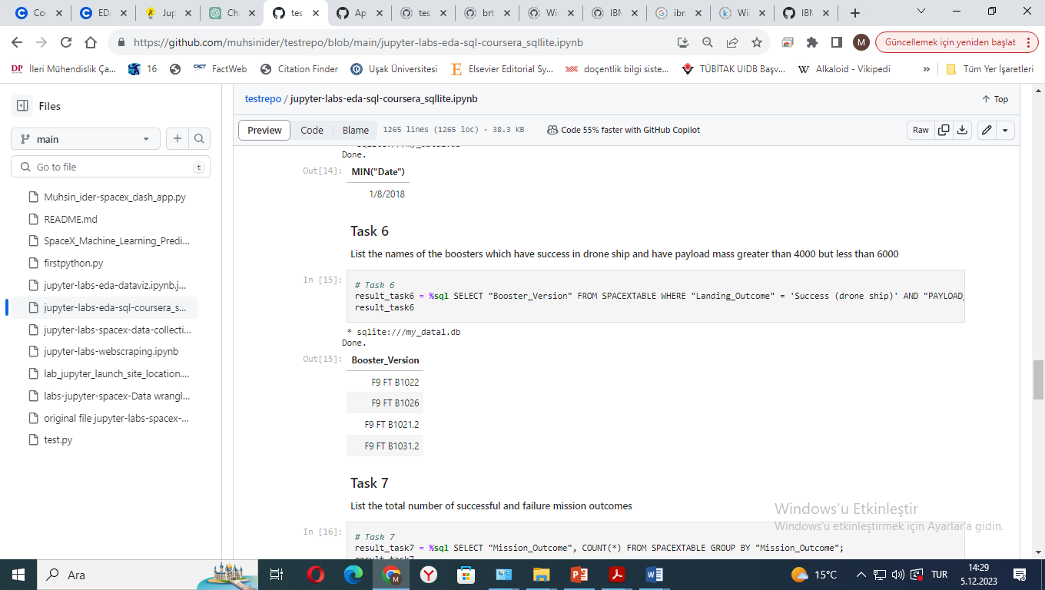
Successful Drone Ship Landing with Payload between 4000 and 6000
Objective: List the names of the boosters that achieved successful landings on a drone ship and carried a payload mass between 4000 and 6000 kilograms.
Query Components:
SELECT Statement: Chooses the booster version names (SELECT "Booster_Version").
FROM Clause: Data is extracted from the SPACEXTABLE table.
WHERE Clause: Applies two conditions — a successful landing on a drone ship ("Landing_Outcome" = 'Success (drone ship)') and a payload mass between 4000 and 6000 kg ("PAYLOAD_MASS__KG_" BETWEEN 4000 AND 6000).
Purpose: To analyze the performance of specific boosters that successfully landed on a drone ship while carrying a significant payload mass.

Slide 34
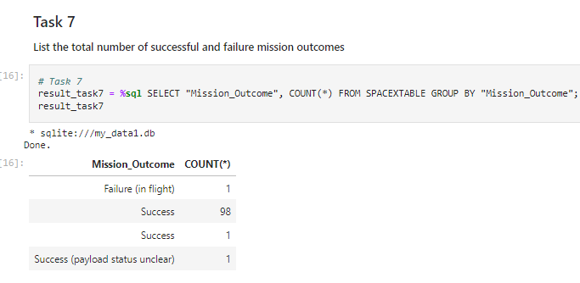
Total Number of Successful and Failure Mission Outcomes
Objective: Count the total number of successful and failed mission outcomes.
Query Components:
SELECT Statement: Groups mission outcomes and counts them (SELECT "Mission_Outcome", COUNT(*)).
FROM Clause: Extracts data from the SPACEXTABLE table.
GROUP BY Clause: Organizes the results by mission outcome (GROUP BY "Mission_Outcome").
Purpose: To evaluate SpaceX's mission success rate by categorizing and counting different mission outcomes.

Slide 35
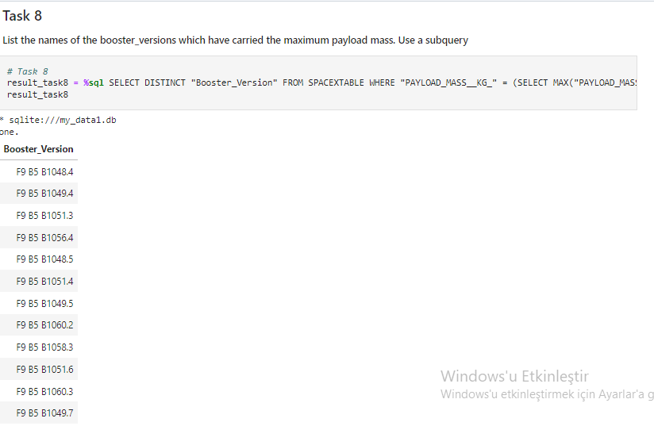
Objective: Identify booster versions that carried the maximum payload mass.
Query Components:
SELECT Statement: Chooses distinct booster version names (SELECT DISTINCT "Booster_Version").
FROM Clause: The data is sourced from the SPACEXTABLE table.
WHERE Clause: Includes a subquery to compare payload masses with the maximum payload mass in the dataset (WHERE "PAYLOAD_MASS__KG_" = (SELECT MAX("PAYLOAD_MASS__KG_") FROM SPACEXTABLE)).
Purpose: To determine which SpaceX booster versions have been used to carry the heaviest payloads, highlighting their capabilities.
Boosters Carried Maximum Payload
Objective: Count the total number of successful and failed mission outcomes.
Query Components:
SELECT Statement: Groups mission outcomes and counts them (SELECT "Mission_Outcome", COUNT(*)).
FROM Clause: Extracts data from the SPACEXTABLE table.
GROUP BY Clause: Organizes the results by mission outcome (GROUP BY "Mission_Outcome").
Purpose: To evaluate SpaceX's mission success rate by categorizing and counting different mission outcomes.

Slide 36
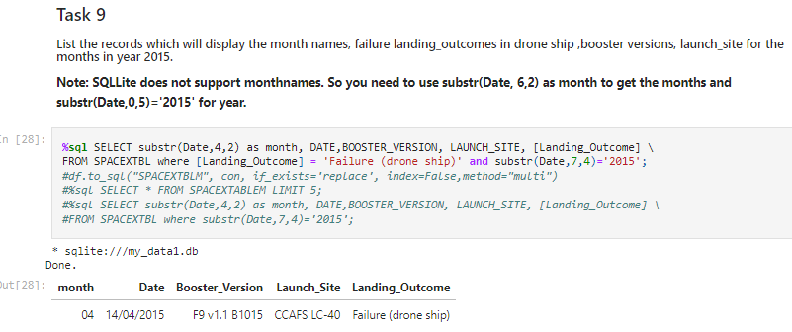
2015 Launch Records
Objective: Display records from 2015 showing months, failure landing outcomes on drone ships, booster versions, and launch sites.
Query Components:
SELECT Statement: Extracts month, date, booster version, launch site, and landing outcome using string manipulation and column selection.
FROM Clause: Data is retrieved from the SPACEXTABLE table.
WHERE Clause: Filters for failed drone ship landings in 2015 (WHERE [Landing_Outcome] = 'Failure (drone ship)' and substr(Date,7,4)='2015').
Purpose: To analyze specific instances in 2015 when SpaceX experienced drone ship landing failures, providing insights into launch outcomes and operations in that year..

Slide 37
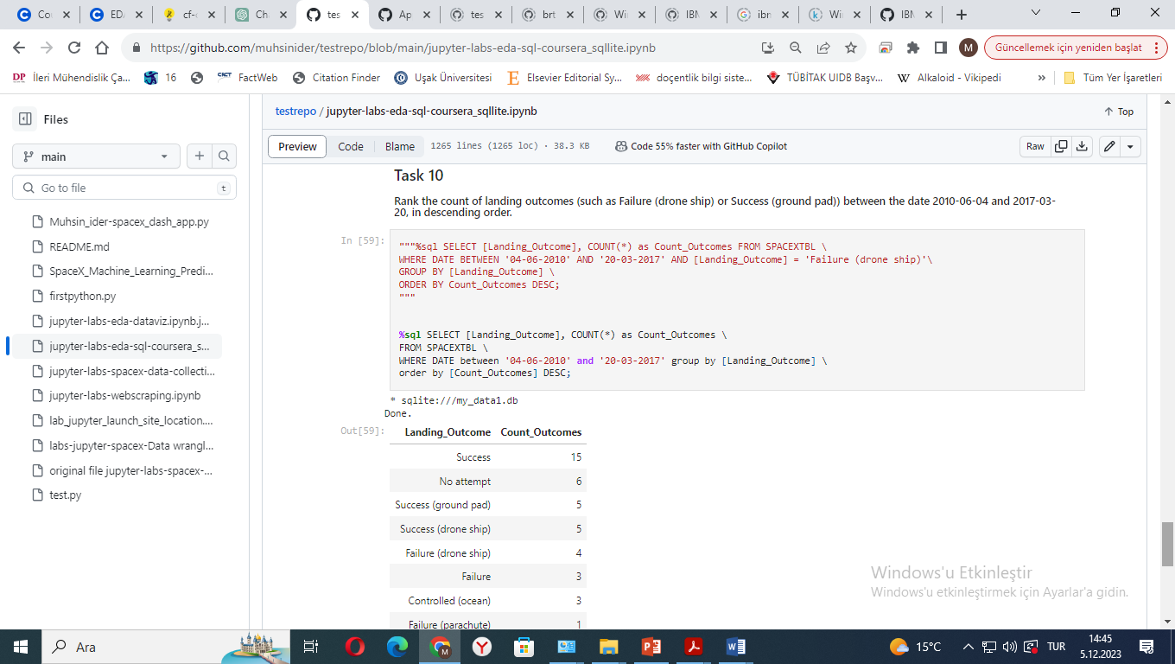
Rank Landing Outcomes Between 2010-06-04 and 2017-03-20
Objective: Rank the count of different landing outcomes between June 4, 2010, and March 20, 2017, in descending order.
Query Components:
SELECT Statement: Calculates the count of each landing outcome (SELECT [Landing_Outcome], COUNT(*) as Count_Outcomes).
FROM Clause: Uses the SPACEXTABLE table for data.
WHERE Clause: Filters the data to include only the missions within the specified date range.
GROUP BY Clause: Organizes the results by landing outcome.
ORDER BY Clause: Sorts the results in descending order of the count of outcomes.
Purpose: To assess the frequency of different landing outcomes over a specific period, providing insight into the reliability and evolution of SpaceX landing techniques.

Slide 38

Section 3

Slide 39
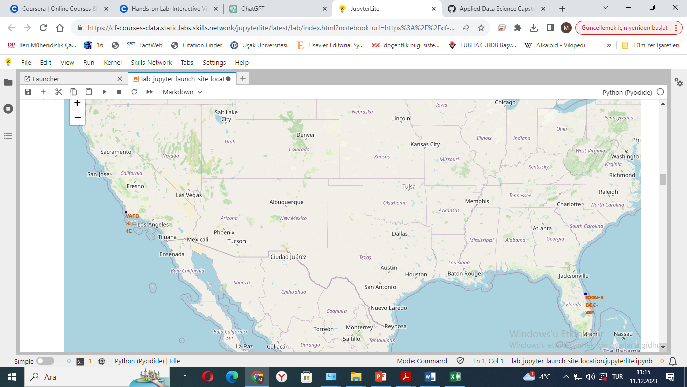
Spacex Global launch Sites with Folium Map
The map provides an overview of SpaceX's global launch capabilities, highlighting the strategic placement of each site to maximize operational efficiency and safety.
Site Names: Includes Kennedy Space Center, Cape Canaveral Air Force Station in Florida, Vandenberg Air Force Base in California.
Coastal Proximity: Each site is near the coast, allowing for oceanic launch trajectories and enhanced safety.
Strategic Placement: Locations are chosen for optimal launch conditions, though not all are near the Equator.

Slide 40
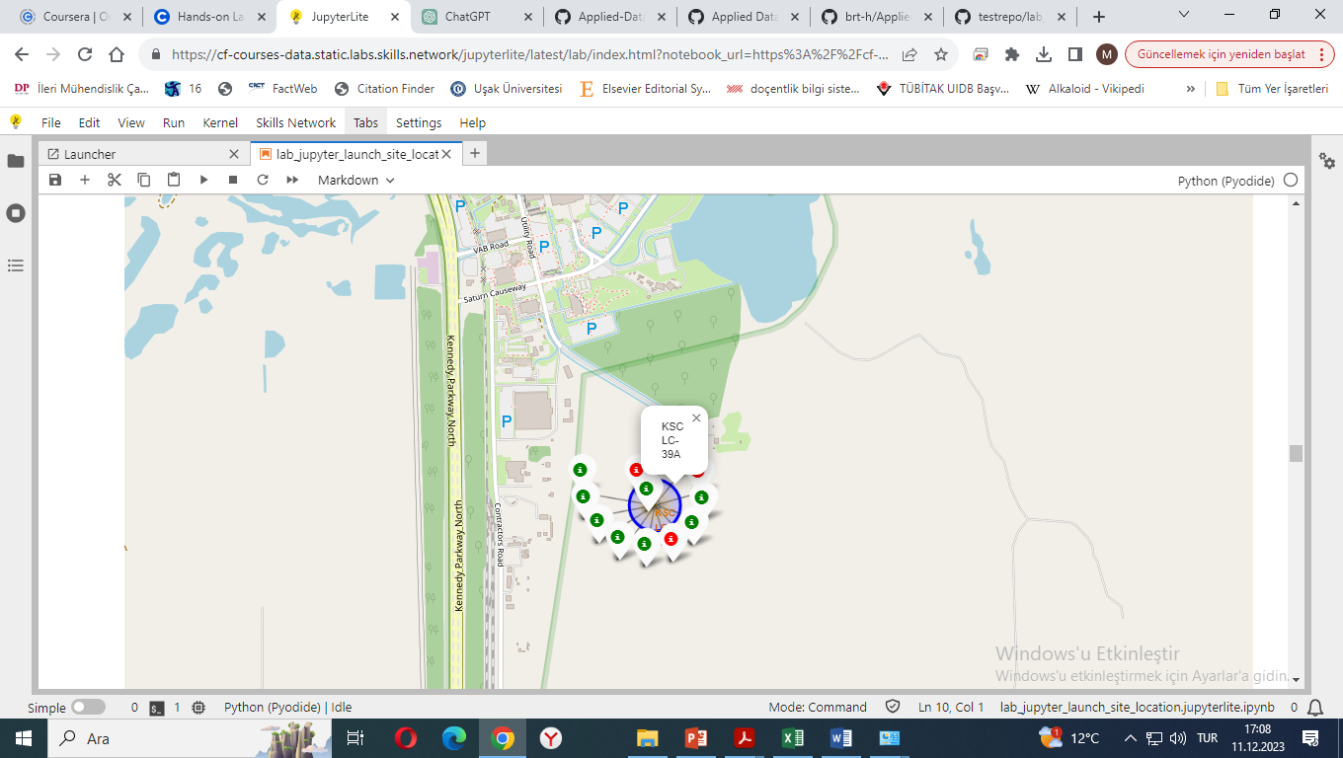
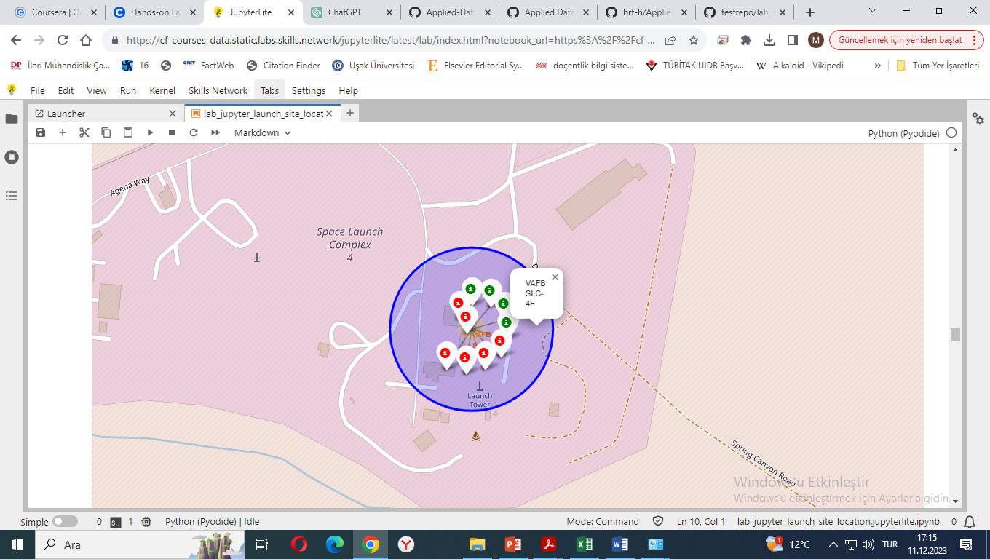
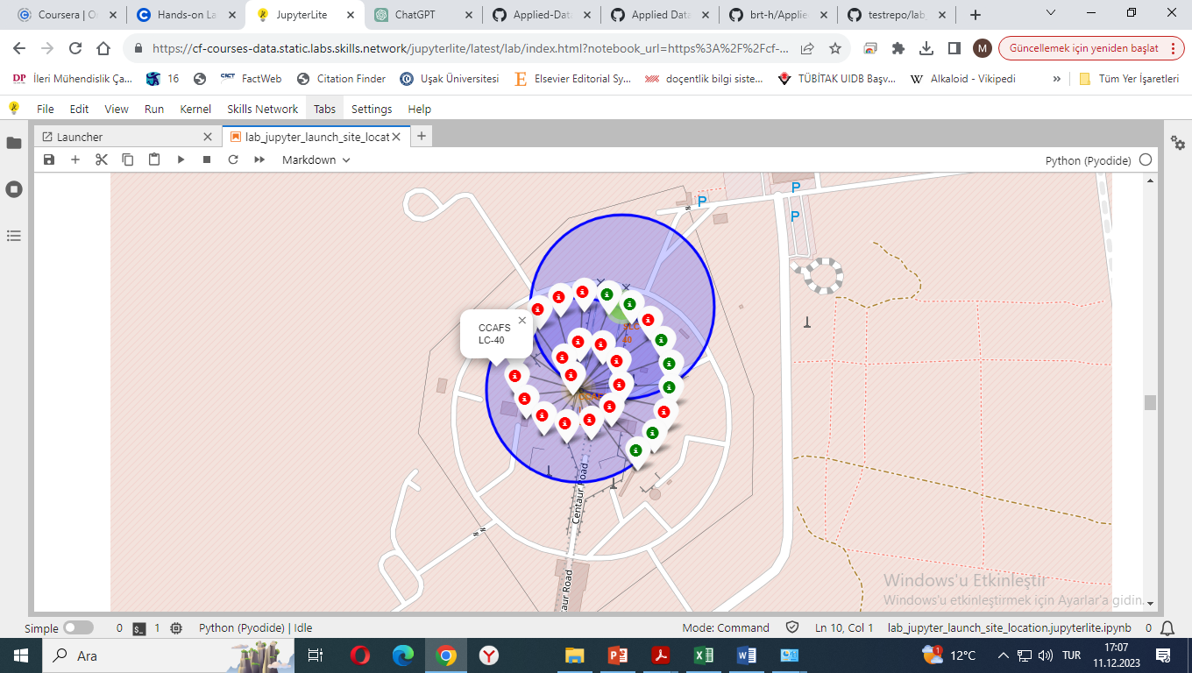
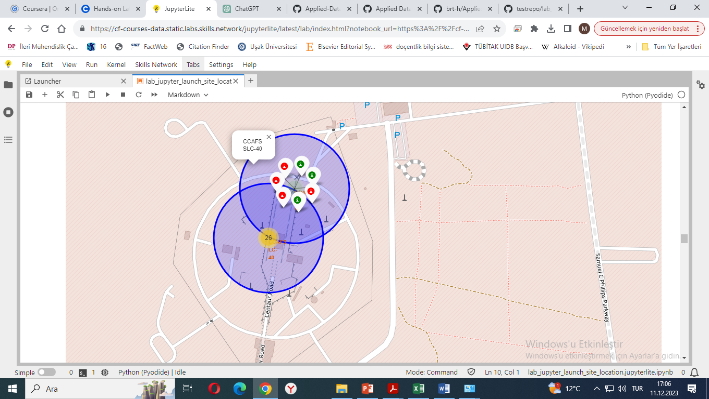
Launch Sites with Colored Success Results
Green: Successfull Launch
Red: Failed Launch
Florida Sites
California Site

Slide 41
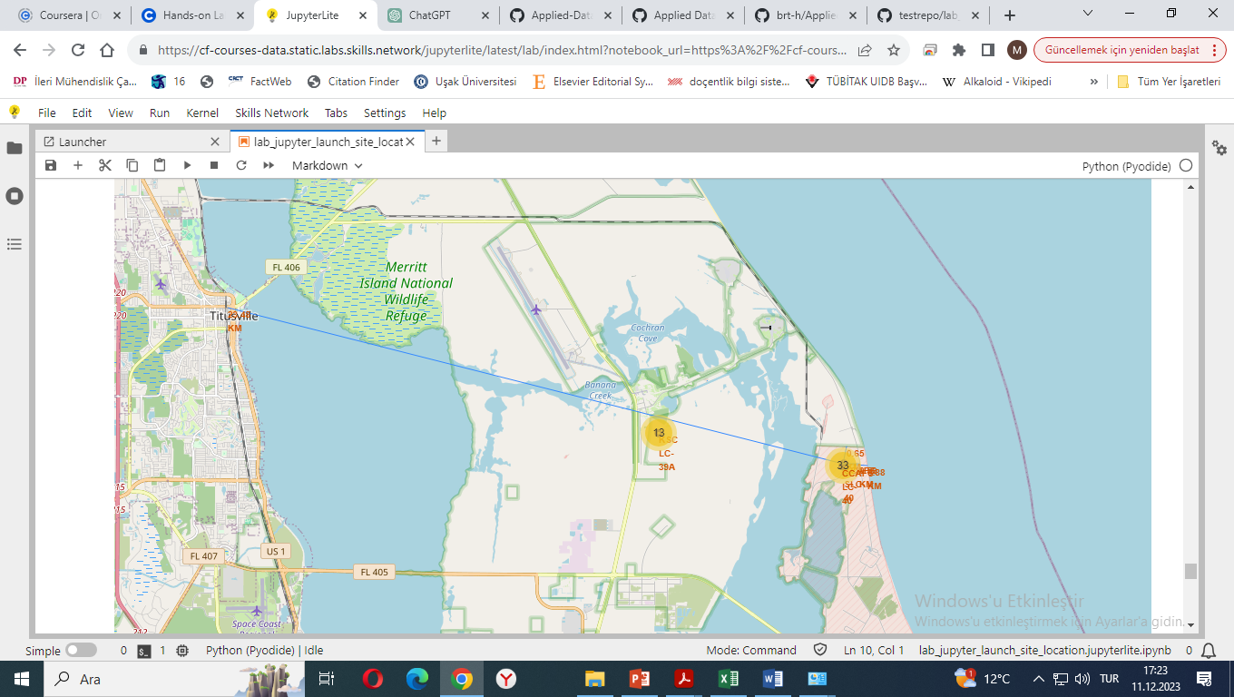
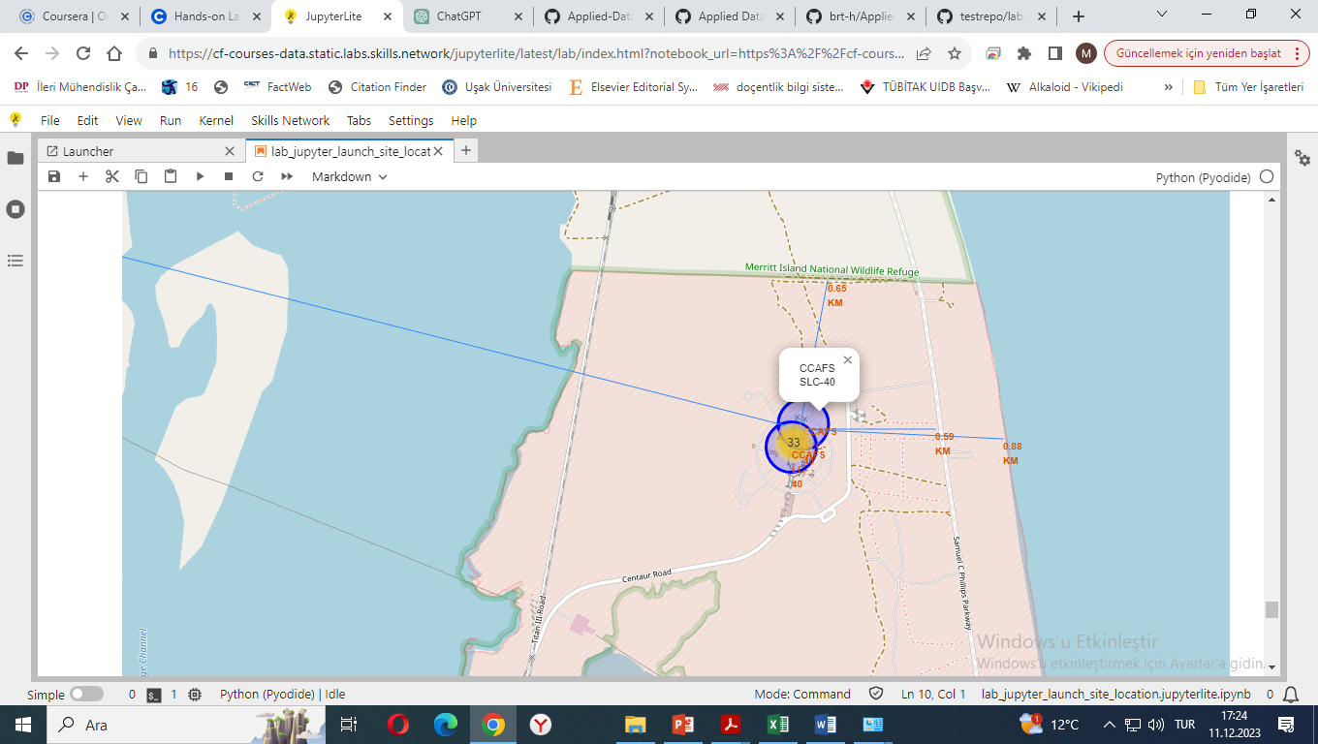
Launch Site Proximities on Map
The CCAFS SLC-40 launch site demonstrates strategic placement with respect to key geographical features for operational efficiency and safety.
Proximity to Railways (0.651 km): Situated close to railways, enhancing the efficiency of material transport and logistics crucial for launch operations.
Proximity to Highways (0.586 km): Located very near a highway, providing essential easy access for personnel and the transportation of equipment.
Proximity to Coastline (0.880 km): Positioned extremely close to the coastline, optimizing for launch safety and leveraging Earth's rotational speed for launch efficiency.
Distance from Cities (23.48 km to Titusville): Established at a significant distance from populated areas like Titusville, ensuring public safety and minimizing impact on urban life.

Slide 42

Section 4

Slide 43
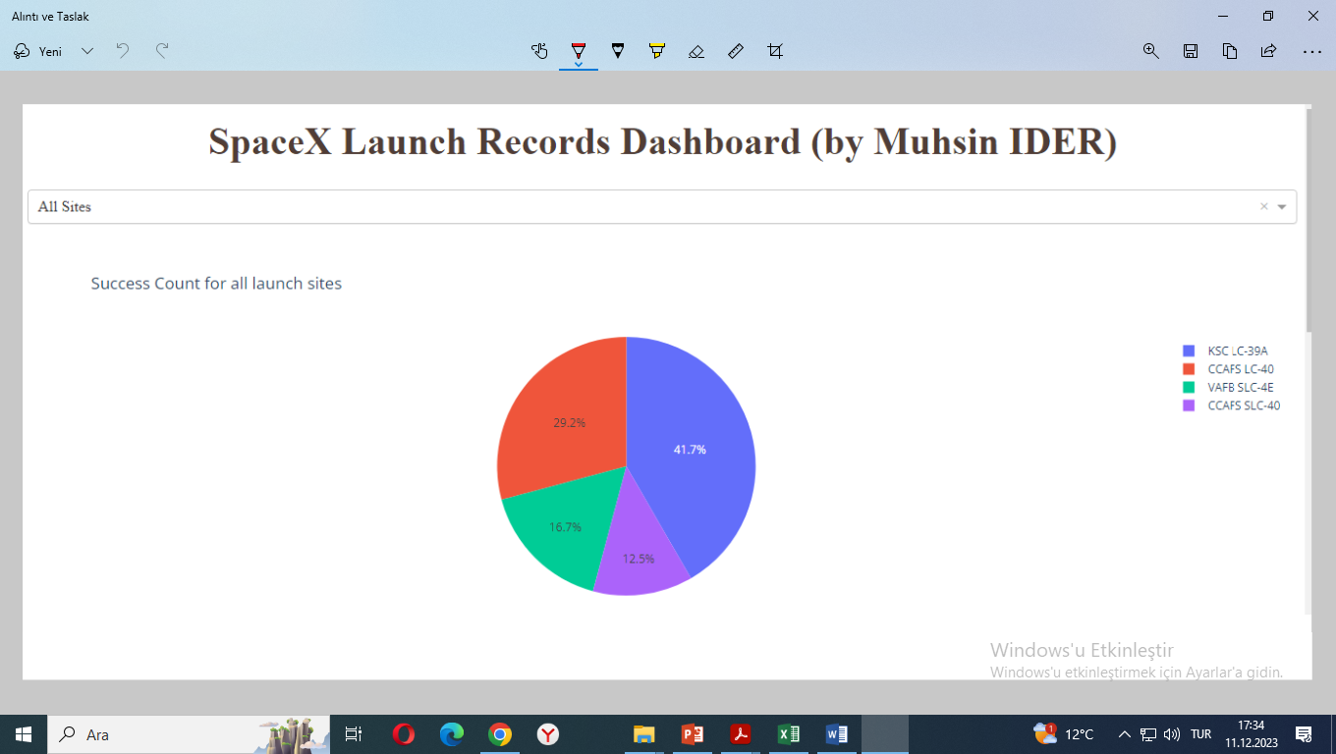
Launch Site Success Ratios
KSC LC-39A: 41.7% of total successful launches
CCAFS LC-40: 29.2% of total successful launches
VAFB SLC-4E: 16.7% of total successful launches
CCAFS SLC-40: 12.5% of total successful launches
KSC LC-39A has the highest share of successful launches, followed by CCAFS LC-40, VAFB SLC-4E, and CCAFS SLC-40.

Slide 44
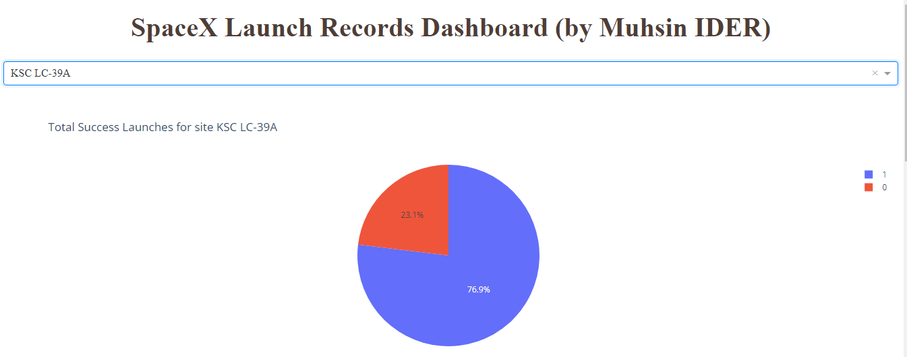
Launch Site With The Highest Launch Success Ratio
KSC LC-39A has the most successful launch ratio of 76.9 %.
Blue(1) : Successful Launches
Orange(0) : Unsuccessful Launches

Slide 45
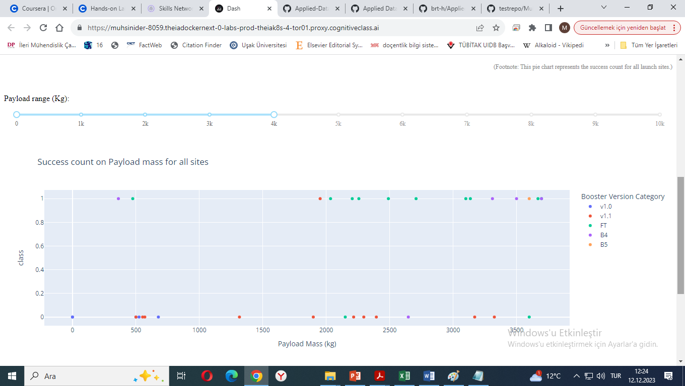
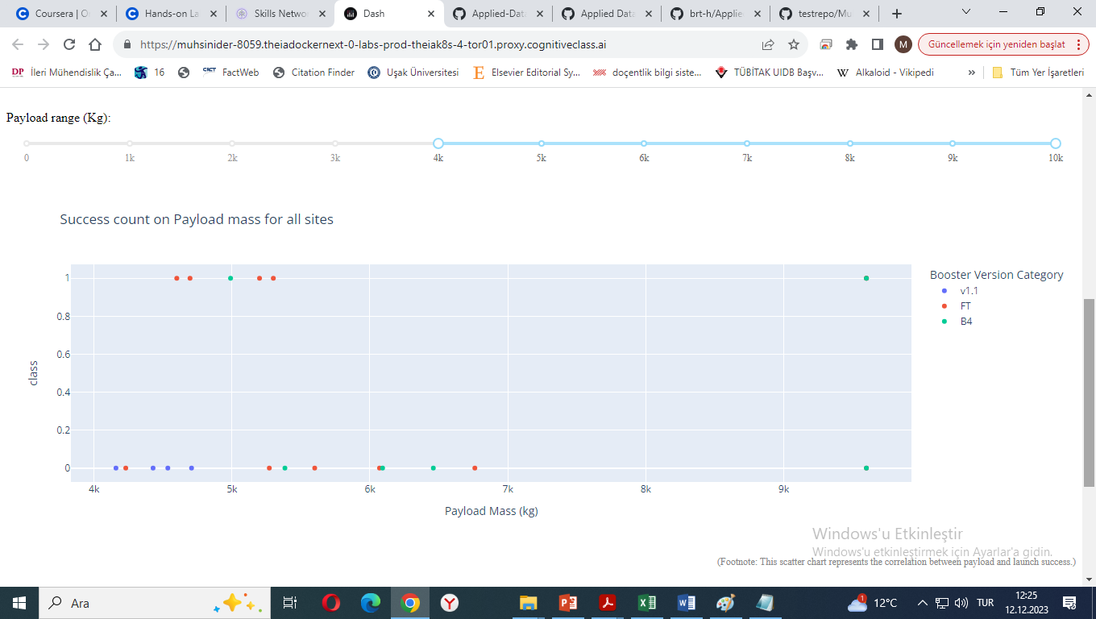
Launch Outcome comparison for different payload ranges
Launches with payloads less than 4000 kg have a higher success rate compared to launches with payloads between 4001 and 10000 kg.
Overall Best Booster Success Ratio:
Booster FT: has 66.67% BEST success rate with 16 successful launches out of 24 attempts.
Booster B4: Demonstrates a 54.55% success rate from 6 successful launches out of 11 attempts.
Booster v1.1: Achieves a 6.67% success rate, with 1 successful launch out of 15 attempts.
Booster v1.0: Records a 0% success rate, with no successful launches out of 5 attempts.
Note: Booster B5 is excluded from this list because of only one launch attempt.
For the payload range of 0-4000 kg, the success rate is 50%.
Booster version FT appears to be the most reliable. The overall success ratio of the FT booster version is approximately 66.67%. with larger number of launches
For the payload range of 4001-10000 kg, the success rate is approximately 36.36%.

Slide 46

Section 5

Slide 47
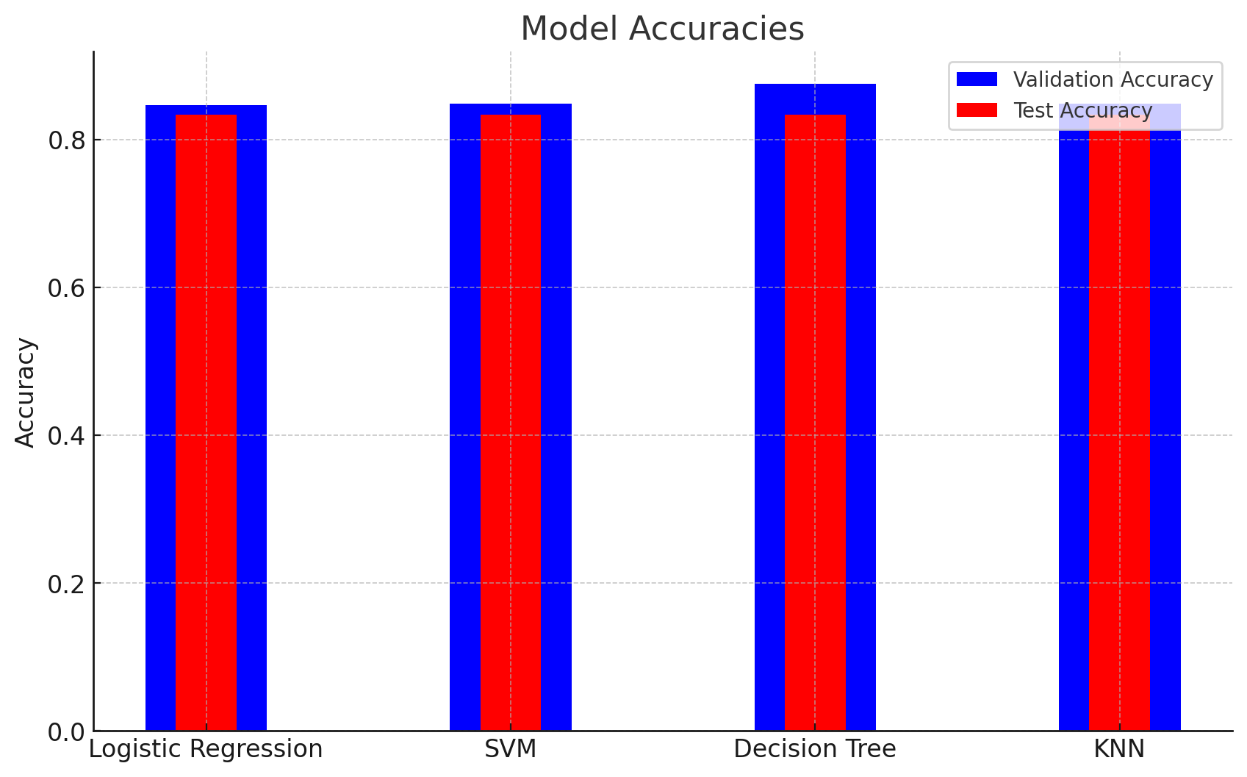
Classification Accuracy
Model accuracies and test accuracies
Logistic Regression:
Accuracy on validation data: 0.8464285714285713
Test set accuracy: 0.8333333333333334
Support Vector Machine (SVM):
Accuracy on validation data: 0.8482142857142856
Test set accuracy: 0.8333333333333334
Decision Tree:
Accuracy on validation data: 0.875
Test set accuracy: 0.8333333333333334
K-Nearest Neighbors (KNN):
Accuracy on validation data: 0.8482142857142858
Test set accuracy: 0.8333333333333334
Logistic Regression, Decision Tree, and KNN have the same test set accuracy of 0.8333
The bar chart visualizes the accuracy for all built classification models. The Decision Tree model has the highest classification accuracy on the validation data with an accuracy of 0.875.
Validation accuracies in blue and test accuracies in red. All models have the same test set accuracy of 0.8333. ​

Slide 48

Confusion Matrix
Model Performance:
All three models (Logistic Regression, Decision Tree, and KNN) have the same test set accuracy of 0.8333
Decision Tree Classifier:
Identified as the best model for predicting successful launches, despite similar test accuracies with other models. The Decision Tree model has the highest classification accuracy on the validation data with an accuracy of 0.875

Slide 49
Conclusions
Launch Site Factors and Characteristics
Location Advantages:
Proximity to the equator and coast for natural boosts and logistical ease.
Launch Site Capacity:
Higher flight volumes at sites correlate with increased success rates.
KSC LC-39A Performance:
Highest success rate overall and 100% for payloads under 5500 kg.
Payload Mass Impact:
Weak correlation with success rate; lighter payloads generally more successful.
Launches above 7,000kg:
Lower risk associated with higher payload mass.
Orbit Success Rates:
ES-L1, GEO, HEO, SSO, VLEO orbits show highest success rates.
Launch Success Trends:
Increase in success rates from 2013 to 2020.

Slide 50
Conclusions
Model Performance and Broader Insights
Knowledge and Experience:
Accumulated launches and experience enhance success rates.
Mission Outcomes:
General trend of successful missions; improvement in successful landings over time.
Model Performance:
Logistic Regression, Decision Tree, and KNN all show 0.8333 test set accuracy.
Decision Tree Classifier:
Best model for launch predictions.
Highest classification accuracy on validation data with an accuracy of 0.875.
Data Source Analysis:
Diverse data sources underscore the importance of data-driven decisions.
Overall Conclusions:
Findings reflect a blend of machine learning model performance, strategic site location, and SpaceX’s evolving capabilities and technology.
These conclusions reflect a combination of machine learning model performance, strategic site location, and the evolution of SpaceX's capabilities and technological advancements over time.

Slide 51
Appendix
All pertinent codes can be found on
GitHub repo: https://github.com/muhsinider/testrepo

Slide 52




Coursera
Applied Data Science Capstone Project

